Slide 1

Review and Remediation:
Building a Sustainable Reparative Metadata Workflow
Project Team:
Broghan White (Presenter)
Meg Mering
Harriet Wintermute
2026 Upper Midwest User Group Conference
November 10, 2026
Notes:
Hello and welcome to READ SLIDE TITLE today at UMWUG.
My name is Broghan White. I am the Cataloging and Metadata Librarian at the University of Nebraska-Lincoln, and I will be speaking about a project that I worked on with my team members Harriet Wintermute, who is the department chair for ACME which stands for Acquisitions, Cataloging, Metadata, and E-Resources at UNL Libraries and Meg Mering, who is a Metadata Librarian.
I’m going walk you through our workflow, starting with the background work before going into the technical side of things for making the changes in Alma and Primo. Then I will highlight some technical challenges we encountered and how we addressed them. And I will finish by sharing outcomes and next steps.

Slide 2

The Pilot Project
From April 2025 to August 2026
5 Library of Congress Subject Headings:
Illegal immigration
Problem children
Sexual minorities
McKinley, Mount (Alaska)
America, Gulf of
Also addressed over 100 subject headings
Operation free icon created by HAJICON - Flaticon
Notes:
We undertook a pilot project to work on outdated and pejorative Library of Congress subject headings in our metadata
Project started in April 2025 and last headings completed in August 2026.
We selected Five LCSH terms as our scope for the pilot, those are:
READ EACH HEADING
We also considered related variants, so subject headings with these terms in them, such as Teachers of problem children or Sexual minority students –
We reviewed and addressed over 100 headings.

Slide 3

Goals
Develop a workflow to replace or supplement pejorative or outdated terms in our metadata
  Establish communication with stakeholders
  Utilize native Alma and Primo tools
  Implement changes across the NU consortium
  Ensure all changes are reversible
Climbing free icon created by Uniconlabs - Flaticon
Notes:
Our ultimate goal was to develop a sustainable workflow for replacing or supplementing pejorative or outdated terms in our metadata, and so we tested a lot of tools and strategies to that end
The work needed to be sustainable, easily manageable, and documented for future use
We approached this work intentionally
Established communication with stakeholders and opened feedback channels
It was important that people knew about what changes we were making and could provide feedback
Always sought feedback before moving forward with changes
To support sustainability, we wanted to use native tools already available in Alma and Primo
Future people don’t need to learn third party tools
We are part of the Nebraska University consortium that includes 5 libraries
we wanted to support our consortium members in the NU system
by rolling out the changes in the consortial environment, Alma’s Network Zone
Not just in our local catalog
That way most of the changes would benefit everyone with the least effort
Lastly, another requirement towards sustainability
Any changes we would make needed to be reversible
The Library of Congress might update their headings to ones we wanted to use again someday
Also language and preferences change over time, so even a currently respectful term might need updating in a few years.

Slide 4


Inspiration from other libraries
University of Toronto:
Indigenous Metadata Work
Washington Research Library Consortium:
Reparative Cataloging CoP
Notes:
This isn't new work—library workers have been challenging biased LCSH terminology for decades.
Other librarians have continued to highlight issues with LCSH, including terminology related to gender, LGBTQ+ communities, and more.
The 2019 documentary Change the Subject brought national attention to student activism at Dartmouth challenging the former LCSH term "Illegal aliens."
ALA's Subject Analysis Committee (formerly under ALCTS, now Core) also examined the use of "Illegal aliens" in LCSH.
The Cataloging Lab's Problem LCSH list provides a community-driven resource for identifying problematic headings and suggesting alternatives.
The Library of Congress is now undertaking a multi-year project to update headings containing "Indians."
Two peer library projects we examined closely for inspiration
University of Toronto used two part approach
They used a strategy where they ‘mask" (or hide) certain LCSH with more appropriate terms in the public display and used local strategies to improve indexing & searching of local subject headings
Washington Research Library Consotrium’s Reparative Cataloging Community of Practice shared their blended approaches that worked in both local and consortial environments
We learned and borrowed a lot of our approach from WRLC

Slide 5

Researching a new term
New terms need to be current and respectful
Learn what terms other libraries and communities use
Referred to a variety of sources for new terms:
  Peer-reviewed literature and databases
  Committee reports and publications
  Blogs, news stories, government agencies
  Community groups
Analytics free icon created by Uniconlabs - Flaticon
Notes:
The first real step in our workflow after identifying a candidate subject heading for reparative work is research, specifically researching a potential new term.
We wanted our new terms to have neutral language, put the person-first, and be current with the relevant communities and fields of study
We checked with other libraries and metadata folks who have adopted newer terms, they might’ve done the research already. Including controlled vocabs like Homosaurus
We used a variety of resources to find our new terms. These could be things like
Peer-reviewed literature; databases to see what terms the field of study are currently using
Professional organization committee reports and related publications (Subject analysis committee)
In some cases, librarian blogs, news articles and government agenices
Also researched how communities are referring to themselves

Slide 6

Action
Determine an action to propose
Replace
  Direct 1:1 change
Conditional
  Change only in some instances
Supplement
  Add new term and retain LCSH
Retain
  Take no action
Action free icon created by nangicon - Flaticon
Notes:
Through the research process, we would determine a course of action that we deemed most appropriate for handling each LCSH
Replace: when we can do a direct one-to-one switch out the old term for the new one
Conditional – not all LCSH can have a 1:1 replacement because of multiple meanings or applications of a subject, so we had instances where we would change this in limited contexts
Supplement – In some cases it’s apparent we need to keep both the old and new term present in the record to help people find the resources. A good example of this use case are the recent changes to federally designated geographic names - it is helpful to have the newer and less known name on the record at the same time as the common or long used name
Retain – Sometimes there are names we can leave alone. This might be based on their use in the field, or because it’s the official name of an event.

Slide 7
Rationale examples 1 & 2
Although these terms refer to the broad group of people who enter or remain in a country without legal authorization, the use of "Illegal," "unauthorized," and "undocumented" imply different connotations and perspectives. Not all immigration starts out as illegal activity. UNL Libraries considers "Undocumented immigration" a more respectful and neutral term to use.
The Library of Congress decided to replace the pejorative "Illegal aliens" heading with a complex solution, two tandem headings, "Noncitizens" and "Illegal immigration." When the immigration heading is present on records with headings containing "Noncitizens" (or many related variations), UNL Libraries will change the heading to use "Undocumented immigrants" instead.
Notes:
So once we have a new term and a desired action, we had to communicate our intentions with our stakeholders
We prepare a rationale to provide an explanation for each change
And grounded our reasons with citations
Reinforces that we are not making these decisions arbitrarily
That we have arrived at this decision with care and intention
We aimed to provide a simple, succinct statement of the facts
using neutral language
Here is an example of two of our rationale statements
There were times we also had to acknowledge tension and complexity (e.g., place names)
We included these rationales in our tracking workbook and in much of our communication
Here we have two example rationales we prepared related to the LCSH “Illegal Immigration”
The first one explains why we want this heading to always change to “undocumented immigration”
The second rationale explains the conditional approach with “Noncitizens.”
In many cases, Noncitizens on its own does not have any inherently bad connotations. But when it appears on records with “Illegal immigration” we wanted to change Noncitizens to “Undocumented immigrants.”

Slide 8
Rationale example 3
Library of Congress and the US Geological Survey (USGS) changed this term due to the signing of Executive Order 14172. As a US institution, it serves our users for our records to be consistent with the geographic names used by government agencies. However, there is an opportunity for confusion and a chance that resources become less discoverable for users who are unaware of the name change or its impact to LCSH. There has also been tension in both public and library discourse surrounding the reasons for the name change and the cultural impacts of the change. UNL Libraries will supplement records with both names.
Notes:
And here’s a third rationale we prepared, related to the geographic place names in our pilot --
McKinley, Mount (Alaska) …. Denali, Mount (Alaska)
America, Gulf of …. Mexico, Gulf of
Here, due to the complexity and tension between federally designated name and cultural or common use, we decided to supplement, our records with the previous term, not replace them.

Slide 9

Inform stakeholders
Communicate our intention with stakeholders
Shared rationale statements for each change
Requested feedback from Libraries staff, groups, and consortium members
Consulted communities and subject experts
Adopted when feedback called for it
Interaction free icon created by nangicon - Flaticon
Notes:
We reached out to various stakeholder groups for their feedback on our proposed change
Audiences:
Libraries faculty and staff (posts in our internal newsletter called Daily Buzz)
Libraries groups related to metadata, Alma, inclusive excellence….
Consortium group related to cataloging
Shared information about the headings and proposed change, along with rationale and resources
Gave about two weeks for feedback, with a reminder post
Targeted outreach when needed:
Community: UNL Pride Affinity Group (Sexual minorities)
Subject expert: educational psychology faculty (Problem children)
Peers: BTAA libraries, UToronto, BTAA Heads of Cataloging meeting
Feedback was largely supportive, and it changed outcomes
In at least one instance, we implemented the feedback provide to us

Slide 10

Making the change
At this point:
Identified term needing reparative work
Chose replacement/supplemental term
Determined an action (replace, supplement, etc.)
Gathered feedback from stakeholders
Choose the technical approach that best suits the desired action. Every approach is easily reversible!
Change free icon created by Flat Icons - Flaticon
Notes:
To help track the steps of the workflow, here is a checklist of the pre-technical work steps
identified a term that needs reparative work
research to see what terminology other groups are using, like other libraries, researchers, and communities related to that term
chosen a potential replacement or supplemental term and written a rationale to support
determined the action we would like to take in repairing the term (replace, supplement, conditional)
Gathered and addressed feedback from all stakeholders and affected communities
Questions remains: how do we do that
Rest of presentation: Tools and strategies for making the changes in our catalog and UNCL catalog
2 Alma environments: IZ for institutional changes and NZ for consortium-wide changes – work done in both
Technical approach determined by our desired action
Some tools are felxible for context, others are all-or-nothing
Changes need to be reversible; will describe how it can be undone

Slide 11

Local Authority Records
A quick and simple way to make direct 1:1 changes
Derived from existing LCSH records
Added field to include rationale for the change
Alma's Preferred Term Correction job automatically changes the subject headings
Used for Illegal immigration, Sexual minorities, and Problem children
Authority free icon created by Flat Icons - Flaticon
Notes:
Quickest approach we took was creating local authority records (AR).
Simple process: derive a new local AR for preferred term from the existing LCSH authority record
In Alma, creating derived ARs are saved in the same vocabulary, so saved in LCSH but local
Good for those direct 1:1 changes as this is an all-or-nothing change
Notes field added to include rationale; people know what the AR is for without extra documentation
Original LCSH retained in alternative term field; important
Alma's preferred term correction job – runs nightly and automatically replaces terms
Uses LCSH in alternative term field and local AR being in LCSH vocab to connect the 2 terms
Makes original LCSH searchable; users get same results searching either term
Undo change by reversing local AR (LCSH in main entry), let PTC job run, delete the local AR
Alma automatically relinks after local AR is deleted
Used for Ill immigration, sexual minorities, problem children

Slide 12
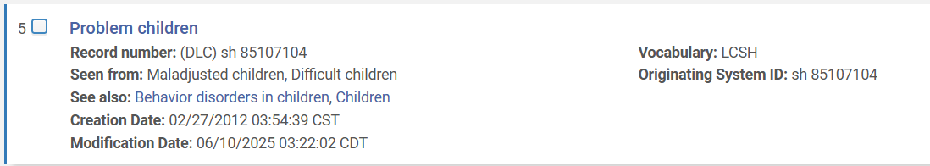
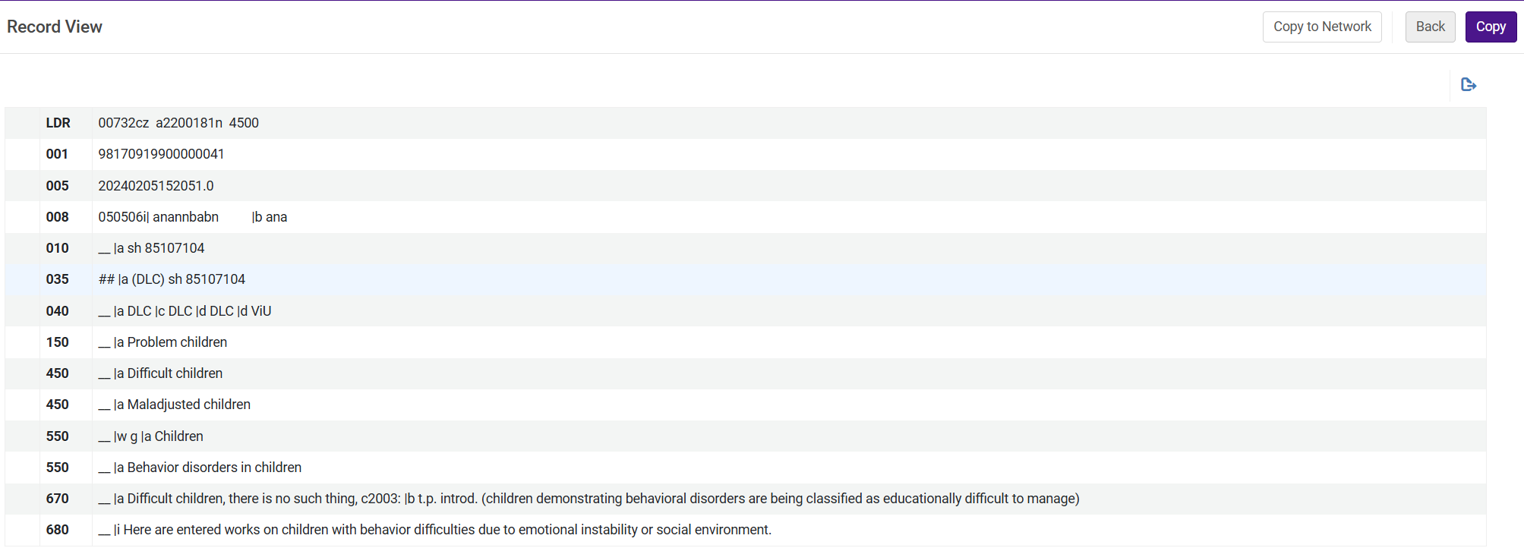
Notes:
Search results for Problem children with LCSH vocab
AR for Problem Children
Main entry (150) - LCSH
Use copy button in the top right corner to create local AR derived from LCSH AR

Slide 13
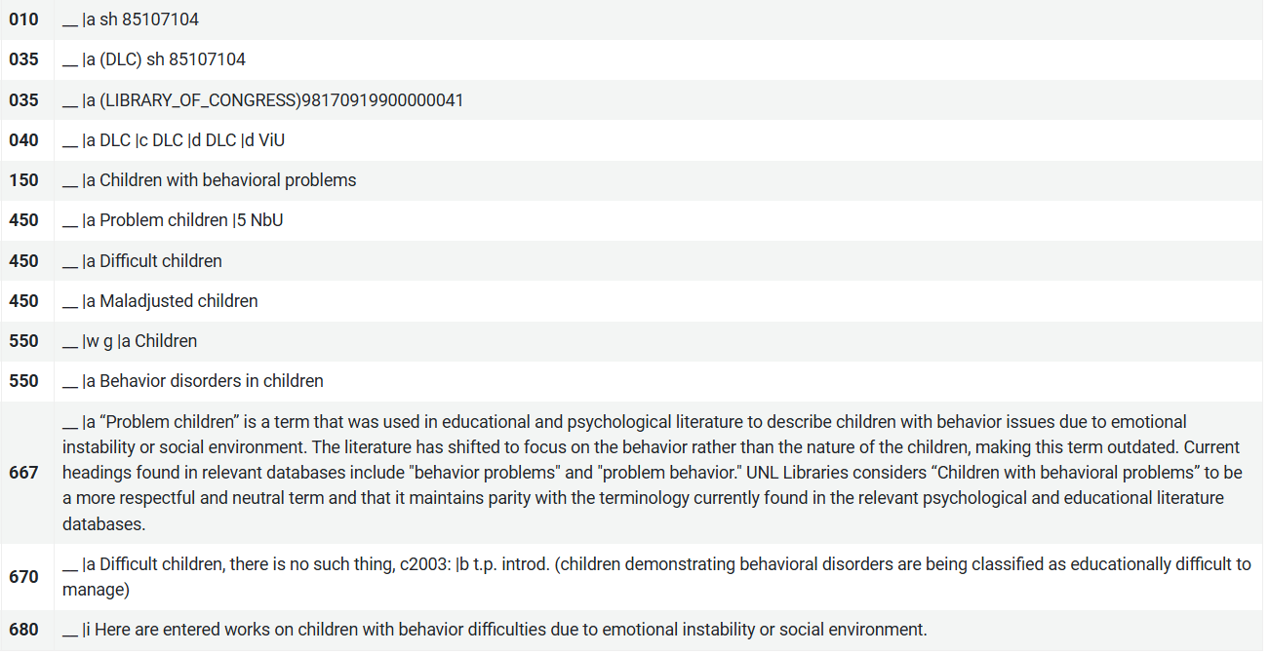
Notes:
Local AR for Children w/ behavioral problems
Main entry (150) - preferred term
Alt term field (450) - LCSH
Notes field (667) - Rationale

Slide 14
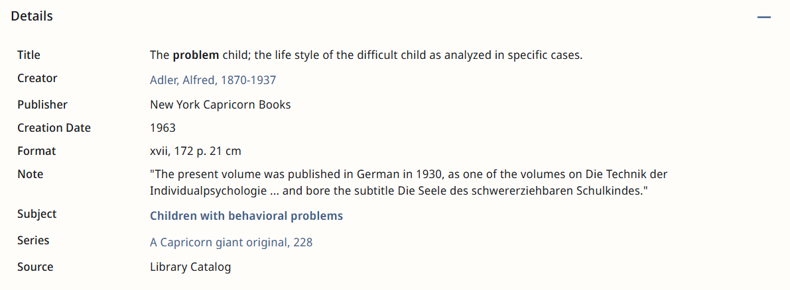
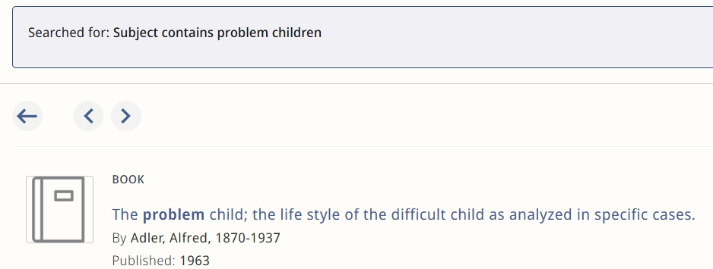
https://unl.primo.exlibrisgroup.com/permalink/01UON_LINC/4occt9/alma991017618739706387
Notes:
Local AR impacted record in display
Local subject is linked
Record was found by searching LCSH Problem children

Slide 15

Normalization Rules
Some LCSH have multiple meanings or contexts that make a direct one-to-one change unsuitable.
Normalization rules can change context-specific subject headings
Used for the subject headings "Noncitizens" only when it appeared in records alongside "Illegal immigration"
Rule is applied quarterly to catch newly added records
Book free icon created by Smashicons - Flaticon
Notes:
Local ARs good for 1:1 changes, but not all LCSH can be changed 1:1
Multiple meaning or contexts that make them impossible to be replaced with a single new term
Example: Noncitizens: used to describe several immigration and citizenship scenarios (e.g. Roman law)
Inappropriate to use Undocumented in that case.
Normalization rules (NR) used for contextual changes (i.e. when it appears with Illegal immigration)
NRs are scripts that can be used to programmatically edit bibliographic metadata
That condition is written into NR (see screenshot)
Rules can be scheduled to run on a logical set of records including all records containing both LCSH – applied quarterly to catch new records
Similar to local ARs, easy to undo. Edit rule to perform opposite action and apply them to records

Slide 16
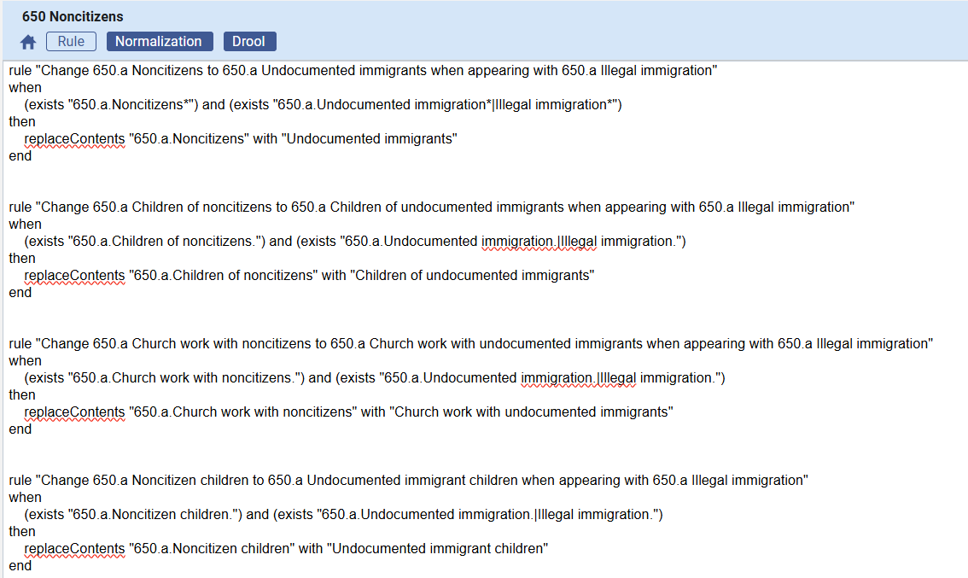
Notes:
Normalization rule in Alma.
Condition requires that both LCSH are present.

Slide 17
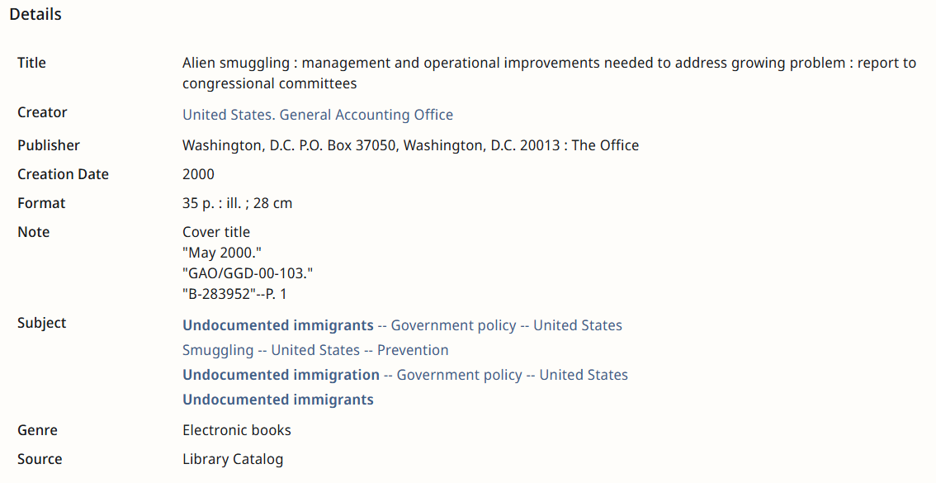
https://unl.primo.exlibrisgroup.com/permalink/01UON_LINC/4occt9/alma991005416739706387
Notes:
A record that has been affected NR in display
New subjects are linked
May be some discovery issues for users searching the LCSH because NR changes the metadata without a connection to original LCSH

Slide 18
Normalization Rules
In some cases, we deemed it appropriate to supplement LCSH rather than replace them.
Normalization rules added our supplemental headings in records that had specific LCSH
This approach was used for the LCSH "America, Gulf of" and "McKinley, Mount (Alaska)" to support discoverability
Added subject term in a local subject field (690)
Notes:
NRs also used for supplementing.
Supplementary approach only used for geographic headings – best for discoverability to have both names
Other name added as a local subject field

Slide 19
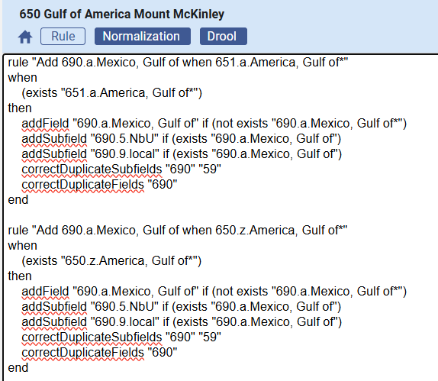
Notes:
Normalization rule in Alma.
Supplements previous names in a local 690 subject field

Slide 20
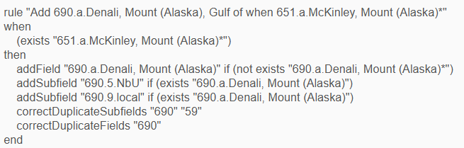
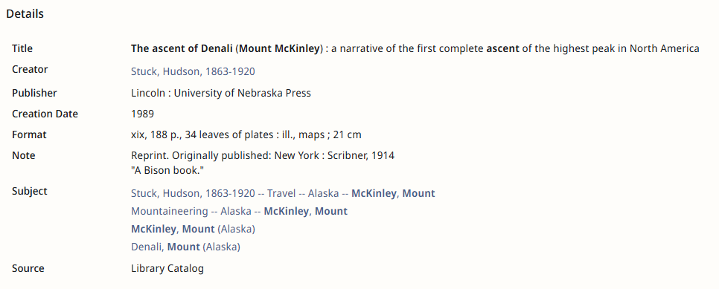
https://unl.primo.exlibrisgroup.com/permalink/01UON_LINC/4occt9/alma991011224519706387
Notes:
Top: part of NR adding the local subject field (690)
Bottom: record in display which has both names

Slide 21
Challenges: Community Zone (CZ)
We are unable to change existing metadata in records sourced from the Alma CZ
Normalization rules can supplement CZ records with preferred subject headings
Subjects are added in a local subject field (690)
LCSH are hidden from display using DEI exclude list in instances of direct 1:1 changes
Notes:
Challenges with Alma's complex environment: specifically with Community Zone (CZ) sourced records
CZ: a shared repository in Alma that contains electronic resource metadata and authority files that is accessible to all Alma users
Unable to edit existing metadata in CZ sourced records
NR used to supplement CZ records with local subject fields (690)
For 1:1 we hid LCSH from display using DEI exclude list – more about that in next slide

Slide 22
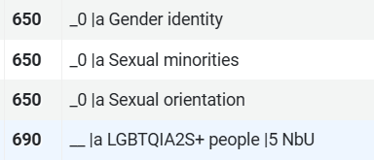
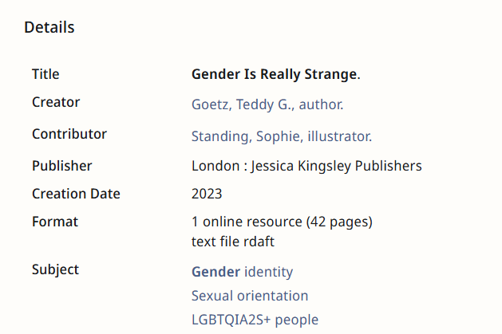
https://unl.primo.exlibrisgroup.com/permalink/01UON_LINC/4occt9/alma991030440199106387
Notes:
Top: subject headings in a record with both LCSH and replacement term
Bottom: affected record in display – no LCSH just replacement term

Slide 23
Challenges: CDI Records
The only tool capable of impacting Central Discovery Index (CDI) records is Alma’s DEI exclude list
The DEI exclude list can remove and replace subject terms and add annotations to subjects in display
It is limited in function and is only useful for direct 1:1 changes in CDI records
Using it will apply to all records, not just CDI
Notes:
CDI, or Central Discovery Index: Ex Libris’s centralized index of scholarly content, including journal articles, ebooks, and other electronic resources
We also cannot edit the metadata in these records
Only tool that affects them is DEI exclude list because it is a discovery tool; requires Alma’s Discovery
DEI exclude list allows you to create a list of words and phrases that can be removed or replaced in Subject fields
Functionality is pretty limited, the excluded word/phrase must match the full subject heading exactly, and it can only hide those subjects from display
We only found it to be useful for direct 1:1 changes in CZ and CDI records
Cannot limit the scope of the DEI exclude list to just CDI records; affects everything

Slide 24
Results
LCSH | Repaired subject heading
Illegal immigration | Undocumented immigration
Problem children | Children with behavioral problems
Sexual minorities | LGBTQIA2S+ people
McKinley, Mount (Alaska) | Denali, Mount (Alaska)
America, Gulf of | Mexico, Gulf of
Notes:
We have replaced Illegal immigration, Problem children, and Sexual minorities as well as nearly 100 variants with the terms Undocumented immigration, Children with behavioral problems, and LGBTQIA2S+ people
In some contexts we have replaced Noncitizens with Undocumented immigrants
We have supplemented the heading for Gulf of America and Mount McKinley with their former names.

Slide 25
Next Steps & Resources
Although the pilot project has finished, the work continues.
A new group will convene to continue identifying problematic and replacement subject headings
We are developing a submission form for users to let us know if they find a subject heading in need of reparative work
We are maintaining a GitHub repository containing our normalization rules and workflows
Notes:
Pilot is finished but we are committed to maintaining a sustainable workflow for reparative metadata work whenever new subject headings are identified
Going forward – 3 items
Draft charge for new group – will identify terms, do research, and communication, but technical work will remain with metadata librarians
Developing a submission form for users and colleagues to submit subject headings they find in our catalog
Maintaining a GitHub repository containnig NRs and other info about our workflows for other libraries to benefit from

Slide 26
Resources
Baron, Jill, and Sawyer Broadley, dirs. Change the Subject. Hanover, NH: Dartmouth Digital Library Program, 2019. https://www.library.dartmouth.edu/digital/digital-collections/change-the-subject.
Baron, Jill E., Violet B. Fox, and Tina Gross. "Did Libraries 'Change the Subject'? What Happened, What Didn't, and What's Ahead." In Inclusive Cataloging: Histories, Context, and Reparative Approaches, edited by Amber Billey, Elizabeth Nelson, and Rebecca Uhl, 53-72. Chicago: ALA Editions, 2024. https://hdl.handle.net/11299/265751.
Berman, Sanford. Prejudices and Antipathies: A Tract on the LC Subject Heads Concerning People. Corrected reprint. Jefferson, NC: McFarland, 1993. First published 1971 by Scarecrow Press. https://archive.org/details/prejudicesantipa0000berm.
Exec. Order No. 14172. "Restoring Names That Honor American Greatness." 90 Fed. Reg. 8629 (January 31, 2025). https://www.federalregister.gov/documents/2025/01/31/2025-02096/restoring-names-that-honor-american-greatness.
Fox, Violet. "Anticipatory Obedience at the Library of Congress." ACRLog (blog), March 28, 2025. https://acrlog.org/2025/03/28/anticipatory-obedience-at-the-library-of-congress/.
Fox, Violet. "Problem LCSH." Cataloging Lab. Accessed October 1, 2026. https://cataloginglab.org/problem-lcsh/.
Notes:
Resources listed here include both resources that we used to help design the workflows and implement the changes technically, as well as the research we used to support our rationale changing each subject heading.

Slide 27
Resources
Friedman, Lisaa. "Trump Wants to Rename Denali. Alaska Lawmakers Don't." New York Times, January 22, 2025. https://www.nytimes.com/2025/01/22/climate/denali-mckinley-alaska-trump.html.
Froetschel, Jen, and Jackie Saavedra. "A Reparative Cataloging Community of Practice in the WRLC." Webinar, ELUNA Learns, December 4, 2024.
Gross, Tina, and Subject Analysis Committee Working Group. Report from the SAC Working Group on the LCSH "Illegal Aliens." July 13, 2016. http://hdl.handle.net/11213/9261.
Hostage, John. "Updating Place Names in the Name Authority File to Reflect Political Realities: The Cases of Crimea, Taiwan, and Myanmar." Cataloging & Classification Quarterly 57, no. 6 (2019): 407–22. https://doi.org/10.1080/01639374.2019.1658676.
Iovannone, Jeffry J. "A Brief History of the LGBTQ Initialism." Queer History for the People (blog), Medium, June 9, 2018. https://medium.com/queer-history-for-the-people/a-brief-history-of-the-lgbtq-initialism-e89db1cf06e3.

Slide 28
Resources
National Park Service. "Naming a Mountain." Denali National Park & Preserve. Last updated March 26, 2025. https://www.nps.gov/dena/learn/historyculture/mountain-name.htm.
Pedersen, Jordan. "Subject-Heading-Masking." GitHub, August 2024. https://github.com/JordanPedersen/subject-heading-masking.
Pedersen, Jordan, and Juliya Borie. "University of Toronto: Indigenous Metadata Work." Webinar, Improving Access to Indigenous Collections Through Classification and Metadata, NASIG, August 14, 2024. https://youtu.be/k88z3is1Jio.
Perera, Treshani. "Ethical Description: Local Solutions." Paper presented at the Music Library Association 2023 Annual Meeting, St. Louis, MO, March 3, 2023. https://works.hcommons.org/records/zzpqc-xnd07.
U.S. Geological Survey, Office of Communications and Publishing. "As Directed by the President, the Gulf of America Enters the USGS Official Place Names Database." February 14, 2025. https://www.usgs.gov/news/featured-story/directed-president-gulf-america-enters-usgs-official-place-names-database.
Vahedyousefi, Saba. "Breaking Down Every Letter in 2SLGBTQQIPAA+." CBC Kids News, June 6, 2023. YouTube video. https://www.youtube.com/watch?v=4Fn5sKfy-vU.

Slide 29

Thank you!
https://go.unl.edu/acme-presentations
unl.metadata@unl.edu
Broghan White | Harriet Wintermute | Meg Mering

